Slide 1
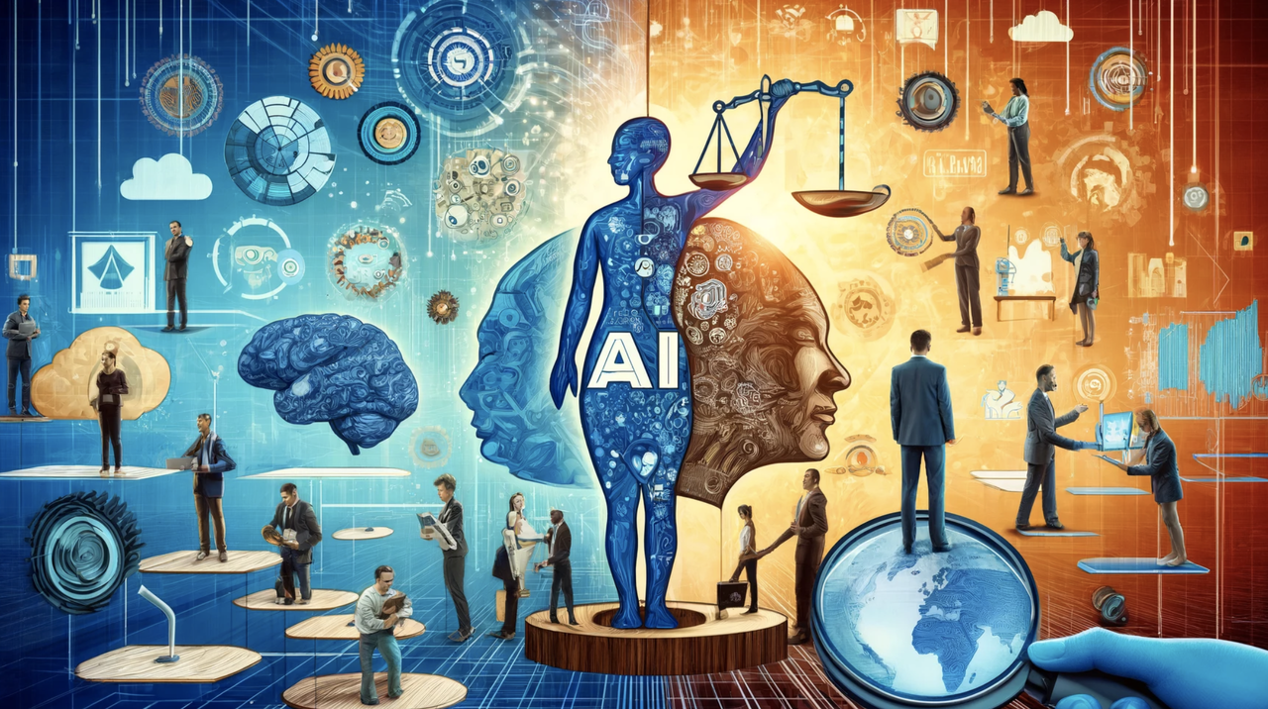
Technology, Growth and Inequality: The Case of AI

Slide 2
A Blessing and a Curse
More accurate weather prediction
Effective Healthcare
Improve education
Assistance in research
Resource Optimization
Improve efficiency and automation
Perform repetitive tasks
Smart Decision Making
Bridging Language Divides
Creating Art
Improved Human Workflows
……
Hallucination
Jailbreak
Fairness
Toxicity
Curb against Discrimination
Access to digital technology
Economic Disparity
Financial Sustainability (exponential rise in development cost)
Environment Issues/ Carbon dioxide
Job Displacement
Technology Gap (Local and Global)

Slide 3
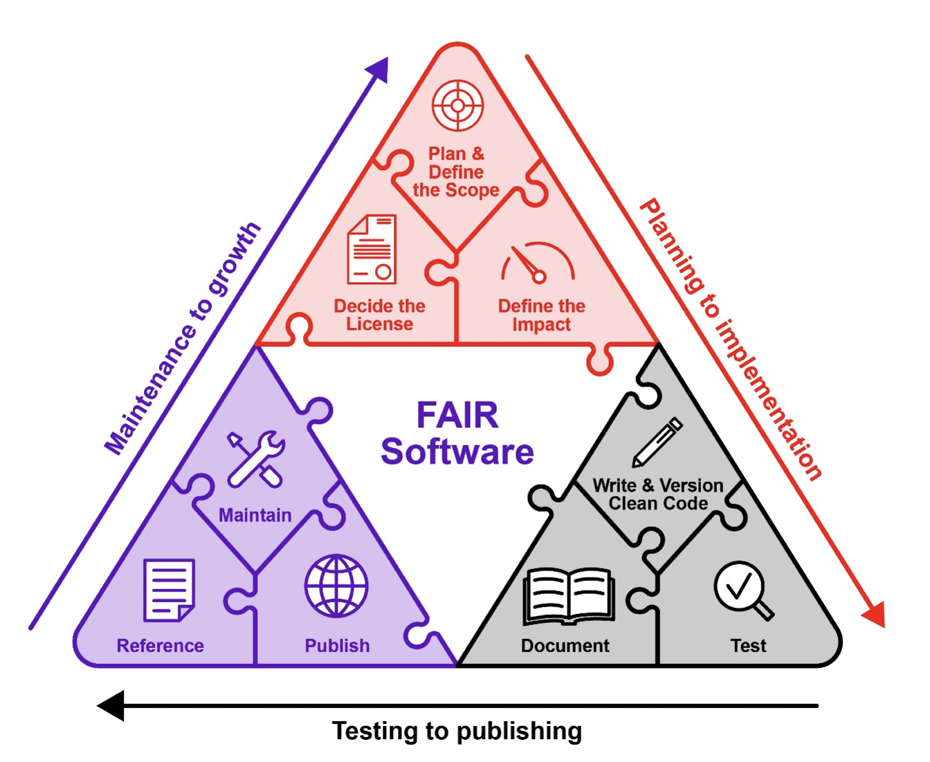
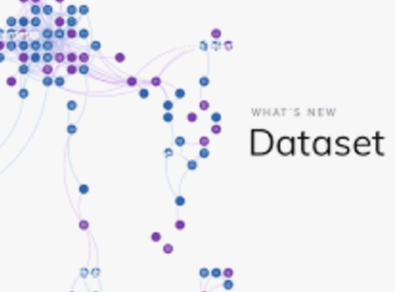
Solution 1: Curb Against Discrimination, Access to Technology, Reduce Technological Gap
Offer Specialized Technical Guidance
2. Provide platform to check Fairness and Bias in AI algorithms
3. Provide useful tutorial video links on AI, Machine Learning & Deep Learning
4 Provide links to helpful AI softwares / datasets

Slide 4
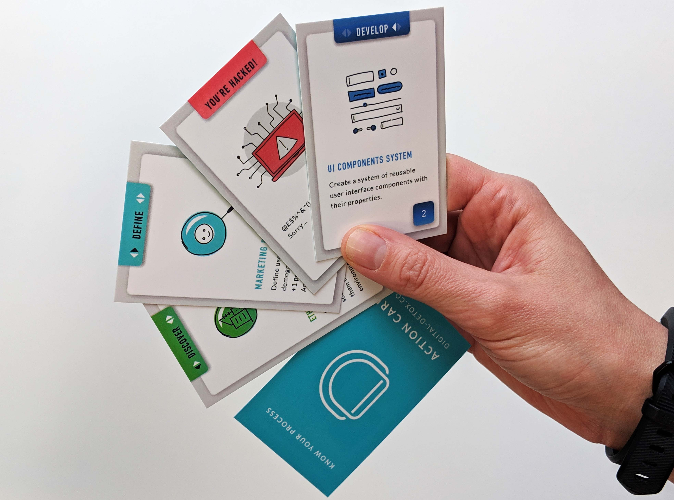
Solution 2: Gamified education
Educational toolkits to promote AI fairness and digital ethics
Game-based learning solutions targeting students, artists, researchers, engineers, policymakers…
Application: formal & informal education, training settings

Slide 5
Capacity building
Social development training courses for AI researchers, designers & developers
AI technology training course for policy practitioners
- following up tech development & how it works

Slide 6
Solution 4: Participatory Social Agreement
Terms on open data frameworks including data sovereignty, regulation of data transfer, storage, and localization
Terms on corporate social responsibility, extra-territorial obligations, and environmental protection (including outside the jurisdiction of the country)
Terms on labour and employment displacements, tax cuts, and algorithmic impact assessments (including remedies for AI harms and enforcements)

Slide 7
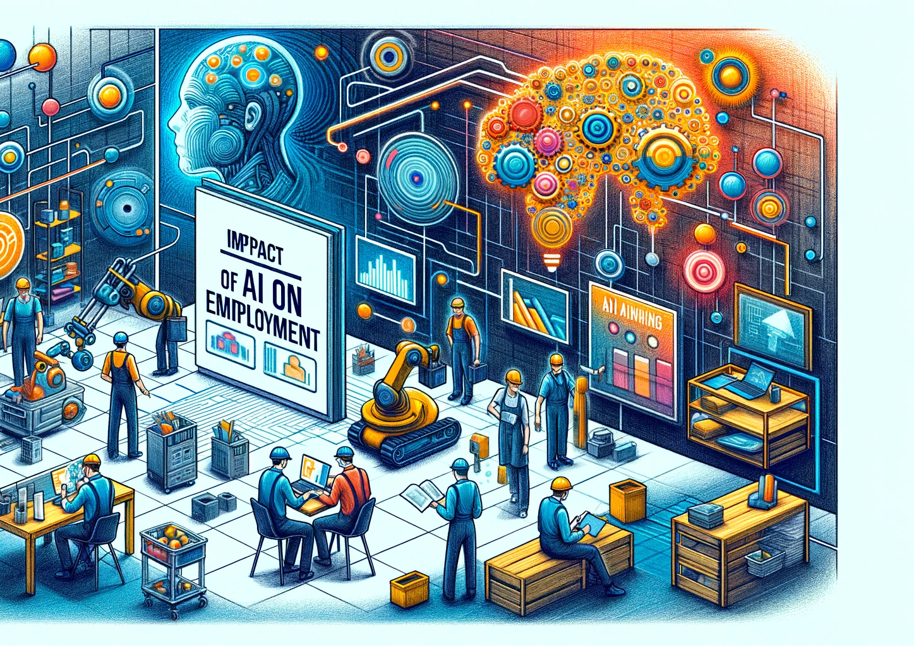
Something-else in the long run
Our website repository: https://salzburgglobalseminar-ai.github.io/
Produce, publish and disseminate academic research
Impact policymakers by engaging in policy advising

